Slide 1
Climate Science in the Classroom and Community
G-WOW Changing Climate Changing Culture Institute
Brian G. Zimmerman
University of Wisconsin – Madison
bgzimmerman@wisc.edu

Slide 2
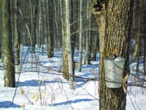
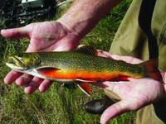
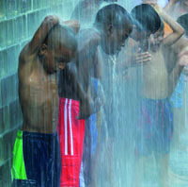
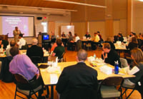
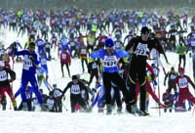
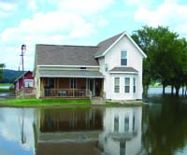
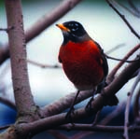
The Wisconsin Initiative on Climate Change Impacts WICCI
WICCI: Enabling climate adaptation in Wisconsin and the Midwest

Slide 3
The Wisconsin Initiative on Climate Change Impacts
Climate
Science
Climate Impacts
WICCI
WICCI’s mission is to generate and share information that can limit vulnerability to climate change in Wisconsin and the Upper Midwest.
Notes:
Change to climate science and impacts.

Slide 4
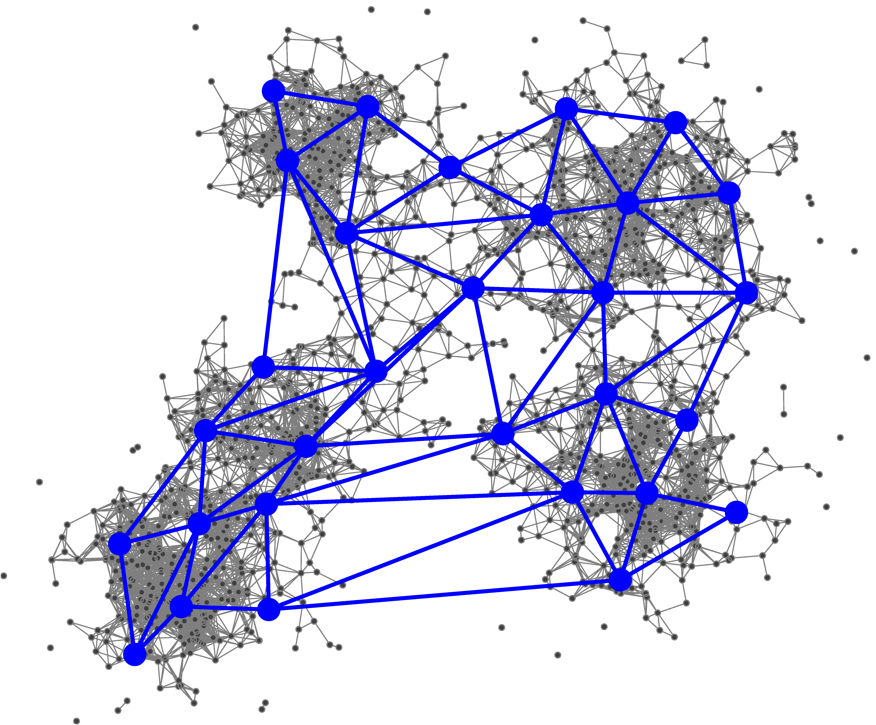
The Wisconsin Initiative on Climate Change Impacts
WICCI is:
An open, decentralized network
WICCI Engages:
Citizens, private and public decision-makers, scientists
WICCI Enables:
Planning, investment, other adaptation activities

Slide 5
Climate Science in the Classroom and Community
Risk as a framework
Adaptation strategies
Focus on vulnerability
Co-benefits
Place-based / Personal stories
Talking about Climate Change

Slide 6
Risk
Risk = Probability × consequence
Risk Assessment
Present Climate
Impact
Threshold
Probability of Dangerous Impact
Probability
Stressor (e.g. Temperature)

Slide 7
Risk
Risk = Probability × consequence
Risk Assessment
Present Climate
Predicted Climate
Impact
Threshold
Probability of Dangerous Impact
Probability
Stressor (e.g. Temperature)

Slide 8
Risk
Mitigation: reduce probability
Risk Assessment
Present Climate
Predicted Climate
Impact
Threshold
Probability of Dangerous Impact
Probability
Stressor (e.g. Temperature)
Mitigation: taking action to reduce the amount of global warming that is expected

Slide 9
Risk
Risk = Probability × consequence
Risk Assessment
Present Climate
Predicted Climate
Impact
Threshold
Probability of Dangerous Impact
Probability
Stressor (e.g. Temperature)

Slide 10
Risk
Adaptation: change consequence
Risk Assessment
Impact
Threshold
Present Climate
Predicted Climate
Probability of Dangerous Impact
Probability
Stressor (e.g. Temperature)
Adaptation: Changing the impacted event so that the consequences are not as bad

Slide 11
Climate Change and Risk:
Risk:
Probability of an event occurring times its consequence
Mitigation
Policies
Low Probability, High Consequence | High Probability, High Consequence
Low Probability, Low Consequence | High Probability, Low Consequence
Adaptation
Policies
Consequence
Probability
Notes:
Risk Assessment Framework: Adaptation policies reduce risk through reducing consequence. Mitigation policies reduce risk through reducing the probability of a certain amount of global warming.
Example: Cows produce less milk if they’re heat stressed. Adaptation would involve building shade structures, mitigation would involve changing the global economy to reduce the probability of extreme global warming.

Slide 12
Using Risk for Engagement
Mitigation ← “Top down” approach, emphasizes global action to produce local change
Politically charged
Distant
Adaptation ← “Bottom up” approach can be more effective at engaging students / community
Less politically charged
Immediately relevant

Slide 13
Climate Change and Risk:
Global
Regional
Local
Policy options for mitigation and adaptation involve very different scales (spatial and temporal)
Near Term Long Term
Adapted from: Morgot and Agrawala:
The Benefits of Climate Change Policies (Ch. 1)
Notes:
Previous example brings up a good point: mitigation and adaptation policies involve very different spatial scales and duration.

Slide 14
Climate Change and Risk:
Global
Regional
Local
Adaptation Benefits
Reduced impact of unavoidable climate change
Near Term Long Term
Adapted from: Morgot and Agrawala:
The Benefits of Climate Change Policies (Ch. 1)
Notes:
Adaptation: Policies and benefits occur on a local scale - for example, changing the size of sewer pipes to prevent overflows. Short term benefits include more resilience to very rare extreme events; long term benefits include resilience to more frequent extreme events.
Building resilience to seasonal climate variability often increases long-term resiliency as well.

Slide 15
Climate Change and Risk:
Global
Regional
Local
Mitigation: Direct Benefits
Avoided climate impacts; uneven distribution; not coupled with location of mitigation
Adaptation Benefits
Reduced impact of unavoidable climate change
Near Term Long Term
Adapted from: Morgot and Agrawala:
The Benefits of Climate Change Policies (Ch. 1)
Notes:
Direct effects of mitigation: Policy options and benefits are large-scale. The benefits to mitigation are not coupled to the location of the mitigation effort (an important point) => requires global diplomatic effort. Benefits are long-term - we have already committed to a certain amount of global warming, and changing the world economy will take a long time.

Slide 16
Climate Change and Risk:
Global
Regional
Local
Mitigation: Direct Benefits
Avoided climate impacts; uneven distribution; not coupled with location of mitigation
Mitigation:
Ancillary Benefits
(Human health, and other benefits from limiting local / regional air pollution)
Adaptation Benefits
Reduced impact of unavoidable climate change
Near Term Long Term
Adapted from: Morgot and Agrawala:
The Benefits of Climate Change Policies (Ch. 1)
Notes:
Ancillary benefits of mitigation: public health, taking advantage of / being prepared for emerging markets. These have some short term benefits, and aggregated can lead to a global effort.

Slide 17
Adaptation vs. Mitigation
Problem: Climate change is seen as a political issue
Mitigation: requires global response, much more politically charged
Adaptation: inherently local, less politically charged
Strategy: Focus on adaptation
“We’re talking about how climate affects us, not how it affects some politician in Washington”

Slide 18
Climate Science in the Classroom and Community
Risk as a framework
Adaptation strategies
Focus on vulnerability
Co-benefits
Place-based / Personal stories
Talking about Climate Change

Slide 19
Strategy: Focus on Vulnerability
Storm Transposition Toolbox (Liebl / Potter)
Use a historical storm to examine vulnerability to flooding
Model hydrological response to that storm over a new area
Advantage: method bypasses personal belief system – we know the storm can happen

Slide 20
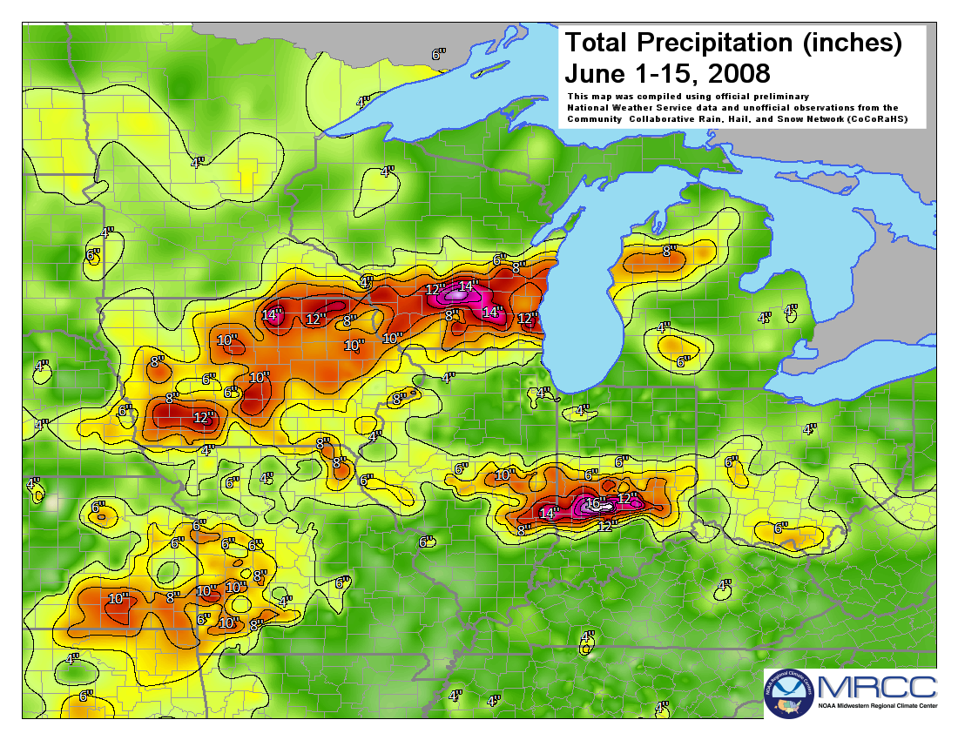
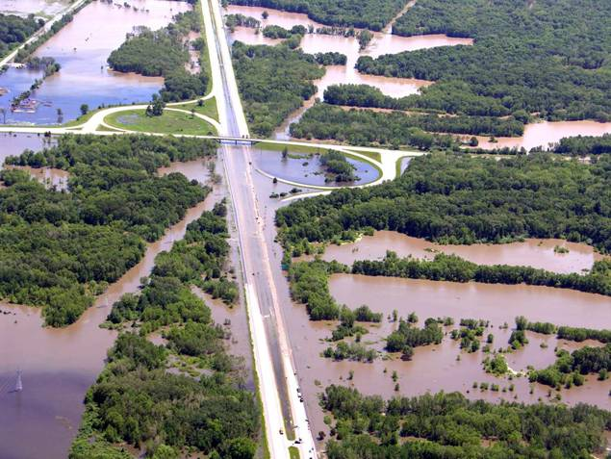
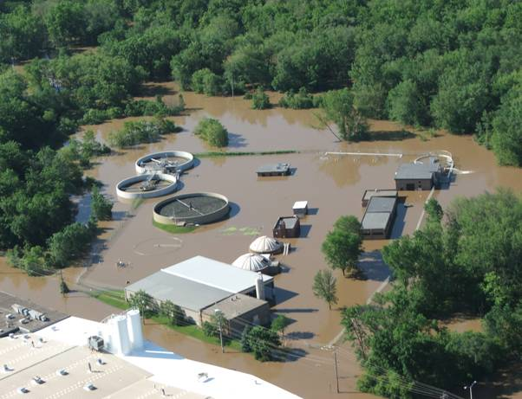
High Water
Storms of June 1-15, 2008
DNR
38 River gauges broke records
810 Square miles of land flooded
161 Communities overflowed 90 million gallons raw sewage
2,500 Drinking water wells tested - 28% contaminated
$34M in damage claims paid Source: FEMA, WEM
Notes:
- Example of regional extreme weather impact.
- 12” to 15” of rainfall over seven days.
- I39/I90-94 closed for three days due to flooding.
- Reedsburg wastewater plant 110 year flood dike submerged. $800k damage, SSO to Baraboo River…FEMA reimbursed.
Source:
Fitzpatrick, F. A., Peppler, M., Walker, J., Rose, W. J., Waschbusch, R. J., & Kennedy, J. (2008). Flood of June 2008 in Southern Wisconsin Scientific Investigations Report 2008-5235. WI: USGS.

Slide 21
Strategy: Focus on Vulnerability
Extreme Storm Transposition
Baraboo
NOAA CSI-SARP
NA12OAR4310098

Slide 22
June 2008 Lake Stage, Transposed Case
Transposed Peak Stage:
853.29’
100 Year
Flood Stage:
852.70’
Duration above 100 Year Flood Stage:
~10 Days
NOAA CSI-SARP
NA12OAR4310098
- Fletcher
Notes:
- Plot compares the elevation and duration of Lake Mendota for both the actual (red) and transposed (green) rainfall.
- Duration of flooding is determined by the rate of drainage to Lake Monona.
- In this example, tail water effects and Lake Monona elevation are not calculated, so duration of the peak stage would likely be substantially longer.
Source:
Daniel Fletcher, Storm Transposition as a means of identifying flooding vulnerabilities in southern Wisconsin, M.S. Presentation, UW-Civil and Environmental Engineering, 2014

Slide 23
853.29’ peak stage
(6” DEM)
NOAA CSI-SARP
NA12OAR4310098
- Fletcher
Notes:
- Figure shows the estimate of inundation from the 853.29’ peak stage, in 6” increments.
- A finer scale DEM and aerial photograph would improve the resolution of the estimate.
- Lake level management and Lake Monona stage would influence peak Mendota elevation and duration.
Source:
Liebl, D.S., K.W. Potter, et al, Storm Transposition Tool Helps Communities to Prepare for Extreme Rainfall, North East Climate Sciences Center, 2015, Amherst, MA.

Slide 24
Strategy: Co-benefits
Look for win-win (or win-win-win…) situations
Climate change is often not the main stressor, but is one of many important considerations
Look for actions that make sense anyway (CFL lightbulbs save energy costs, and reduce carbon)
Advantage: easier to bypass excessive risk tolerance

Slide 25
Strategy: Co-benefits
LaCrosse, WI Climate Change Adaptation workshop
Identify flooding risk
EPA grant for green infrastructure
Dane County Emergency Management Budget
Identify risk from climate change due to extreme rainfall events
Better preparedness to climate change increases overall resilience

Slide 26
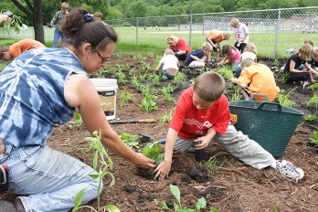
Strategy: Co-benefits
WI Earth Partnership for Schools
Rain gardens improve general sustainability
Look for opportunities to incorporate climate change resilience into existing activities
Advantage: Improve overall sustainability, recognize complexity

Slide 27
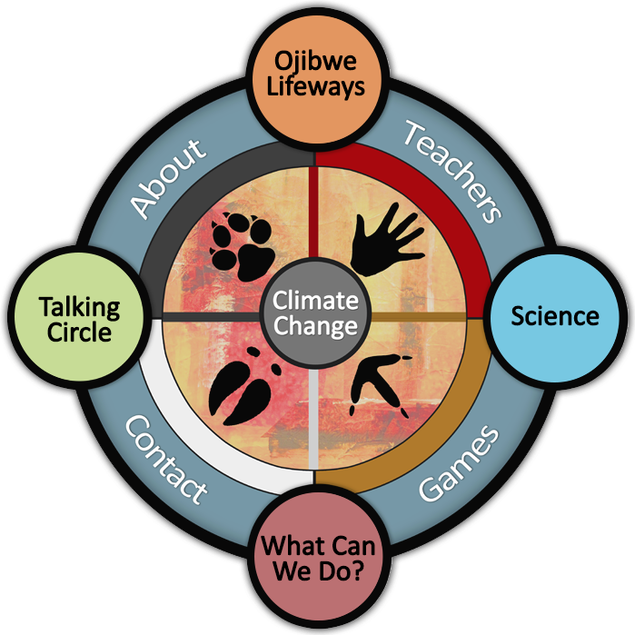
Strategy: Place-based approach
Build awareness of climate impacts through relating to personal experiences
Advantage: placed-based inquiry demonstrates immediacy of climate change impacts
Notes:
Plac ebased and bottom up.

Slide 28
Local → Global Approach
We experience local conditions
Begin with local experience in order to engage students / community in the conversation
Move toward discussion of global responses that could / should be taken
Distinctions between adaptation and mitigation are useful here

Slide 29
Climate Science in the Classroom and Community
Risk as a framework
Adaptation strategies
Focus on vulnerability
Co-benefits
Place-based / Personal stories
Talking about Climate Change

Slide 30
Adaptation vs. Mitigation
Problem: Climate change is seen as a political issue
Mitigation: requires global response, much more politically charged
Adaptation: inherently local, less politically charged
Strategy: Focus on adaptation
“We’re talking about how climate affects us, not how it affects some politician in Washington”

Slide 31
Thermometers don’t vote
Problem: Climate science is lumped into the political and economic debate of how we should respond
Strategy: Point out that climate change is a scientific issue, not a political issue
How should we respond? This question does require political and economic discussion.
“It’s hard to argue with a thermometer. How we should respond to climate change, though, is an important issue that we should discuss.”

Slide 32
Acknowledge the elephant
Problem: There is political pressure to affirm or deny climate change
Strategy: Acknowledge the politics and point out ways to avoid it.
“We are in the business of making the best decisions possible, with the best information available, about our natural and economic resources”
“We are not trying to promote doomsday scenarios, we are here to ensure an informed response to a serious environmental issue.

Slide 33
Focus on vulnerability
Problem: Political identity affects our willingness to address climate change
Strategy: Focus on historical vulnerability
“We know this kind of event is possible, because it struck our neighboring town. We should use their experience as a learning opportunity.”
“We’re not talking about a hypothetical future, we’re talking about what we have all experienced.”

Slide 34
Climate Denialism
Problem: Denialism derails the conversation from the outset.
Strategy:
Know / anticipate your audience.
Individuals: Triage (you can’t change everyone’s mind).
Community efforts: Start with observed events or observed climate change to engage the community.

Slide 35
Climate Denialism
Denialist arguments:
Arguments are typically based on a legitimate piece of evidence, data, or argument.
Identify and acknowledge the nugget of truth
Point out how that fact supports a different conclusion

Slide 36
Legitimate Arguments
Problem: There are legitimate arguments about details of climate research
Strategy: This is not a problem! Embrace these arguments! They only add to our understanding, and rarely negate the theory.
“That is an important consideration. Here is how we have accounted for that consideration in our efforts.”

Slide 37
Climate variability vs. change
Problem: The phrase “climate change” can cause immediate disengagement
Strategy: Focus on climate variability (year to year changes, etc.) This will also increase resilience to climate change.
“We all know that any one winter can be very different from the next. We should be prepared for this kind of climate variability.”

Slide 38
Some more examples…
Skeptical Science

Slide 40
Strategy: Place-based inquiry
http://www.chicagobotanic.org/nasa

Slide 41
www.ClimateWisconsin.org
Stories of how climate affects a wide range of issues in our state
Suggestions for educational activities related to each story
www.climatewisconsin.org

Slide 42
National Climate Assessment
https://www.climate.gov/teaching/2014-national-climate-assessment-resources-educators

Slide 43
NASA Climate Resources
http://climate.nasa.gov/resources/education/
http://climate.nasa.gov/

Slide 44
WDNR Climate change Guide
http://dnr.wi.gov/eek/teacher/climatechangeguide.htm

Slide 45
WICCI
http://www.wicci.wisc.edu/news-kidsandclimate.php
http://ccr.aos.wisc.edu/resources/data_scripts/wisconsin_climate/

Slide 46
Resources
G-WOW: http://www.g-wow.org/en-us/default.aspx
WICCI: http://www.wicci.wisc.edu
WICCI “Interactive” Maps: http://ccr.aos.wisc.edu/resources/data_scripts/wisconsin_climate/
ClimateWisconsin: http://www.climatewisconsin.org
Chicago Botanic Garden: http://www.chicagobotanic.org/nasa
National Climate Assessment: https://www.climate.gov/teaching/2014-national-climate-assessment-resources-educators
NASA Climate Resources: http://climate.nasa.gov/resources/education/ and http://climate.nasa.gov/
Wisconsin DNR Climate Change Education materials: http://dnr.wi.gov/eek/teacher/climatechangeguide.htm
GlobalChange.gov: http://www.globalchange.gov/browse/educators

Slide 47
Strategy: Triage
DNR Driftless Area Master Plan
Trout habitat will greatly diminish with climate change
Some streams are already extremely vulnerable – assume these are lost
Some streams will likely be fine – these streams do not need resources for additional restoration
Advantage: efficient use of resources, community involvement in decision-making

Slide 48
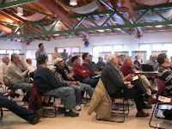
The Wisconsin Department of Natural Resources used WICCI results to help prioritize management priorities for their Driftless Area Master Plan
Notes:
Trout fishing contributes more than $1 billion per year to the Driftless Area economy
$45 million invested to restore over 450 miles of streams
2011: tourism provided 469 jobs and $28.8 million to Vernon County, WI

Slide 49
Climate Science in the Classroom and Community
Risk as a framework
Adaptation strategies
Focus on vulnerability
Triage
Co-benefits
Place-based / Personal stories
Some resources for climate education

